Slide 1
Azure Devops DEEP-DIVE Updated 14 October 2020

Slide 2
ADODD > Agenda
Pipelines
Projects
Repos
Boards
Big Picture
Artifacts

Slide 3
ADODD > Big Picture
Why do we need DevOps?

Slide 4
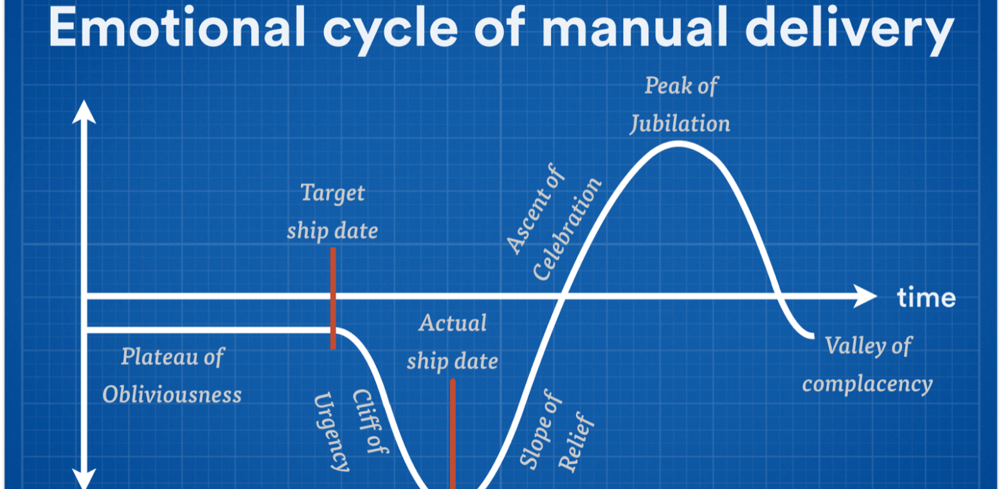
ADODD > Big Picture > Challenge
Notes:
How quickly you can fail fast or double down is determined by your cycle time. Your cycle time determines how quickly you can gather feedback to determine what happens in the next iteration. The feedback that you gather with each cycle should be real, actionable data. Manual delivery increases cycle times exponentially.

Slide 5
ADODD > Big Picture > Challenge
Repeated manual tasks are prone to errors and inconsistencies
Longer cycle times lead to lower ROI and wastes expensive IT resources
Centralized management introduces anomalies in decentralized environments
Cross-cutting concerns slows issue resolution
Manual delivery requires significant resource, carry greater risks and have long cycle times

Slide 6
ADODD > Big Picture
What is DevOps?

Slide 7
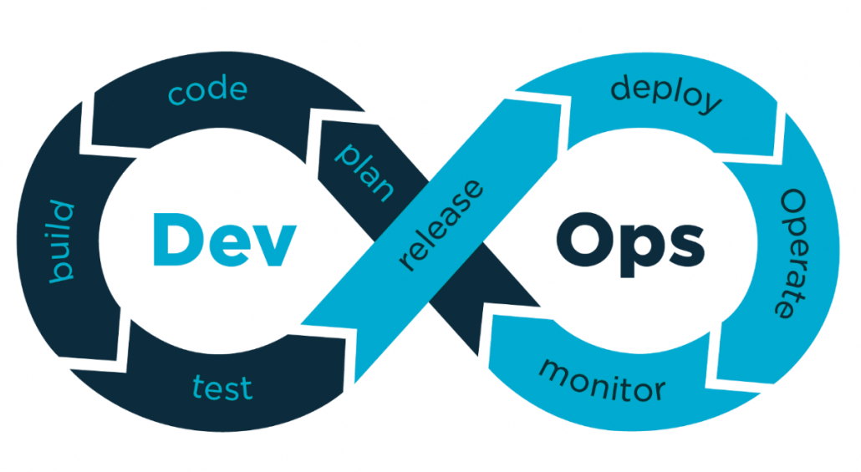
ADODD > Big Picture > DevOps

Slide 8
ADODD > Big Picture > DevOps > Characteristics
DevOps culture stresses small, multidisciplinary teams, who work autonomously and are collectively accountable
For a DevOps team, there’s no place like production. Everything they do is about making customers’ live experience better
DevOps teams work tirelessly to reduce cycle times and break down traditional barriers between Development and Operations
Essential DevOps practices include agile planning, continuous integration, continuous delivery, and monitoring of applications.

Slide 9
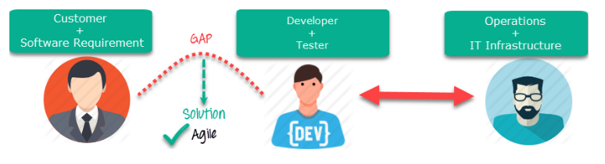
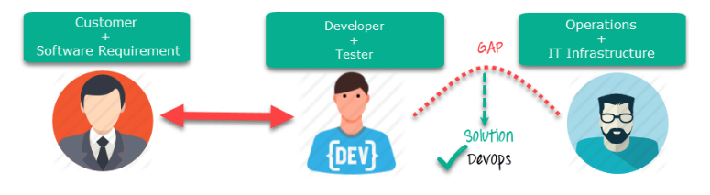
ADODD > Big Picture > DevOps > Process
Notes:
Agile => focuses on the gap between Business and IT.
DevOps => focuses on the gap between Development and Operations.

Slide 10
ADODD > Big Picture > Continuous Delivery
What is Continuous Delivery?

Slide 11
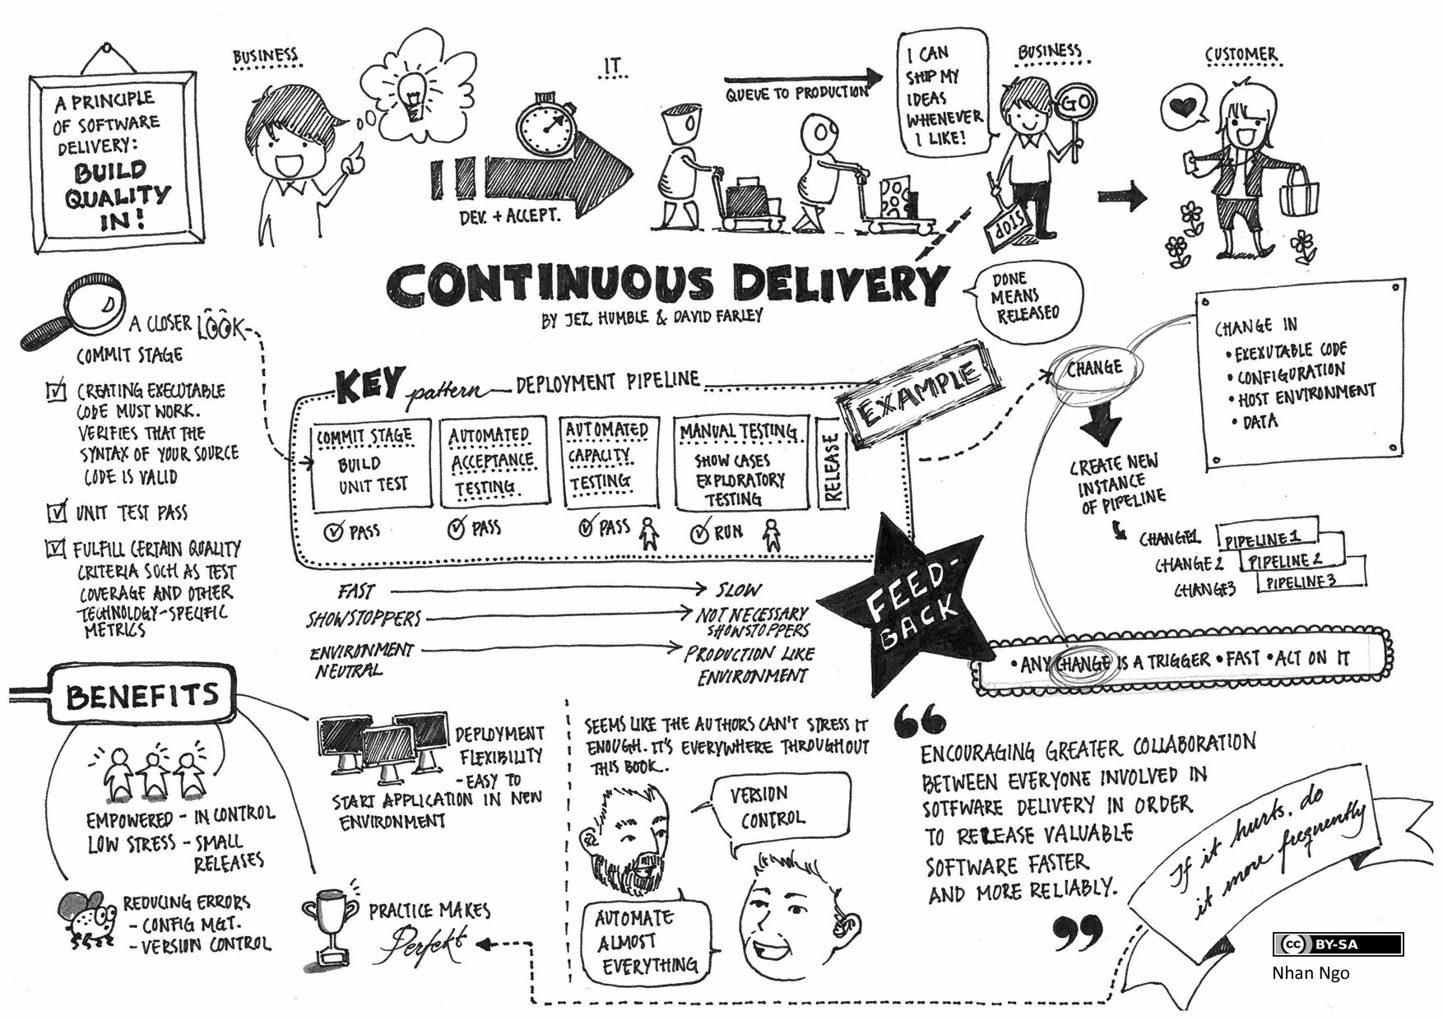
ADODD > Big Picture > Continuous Delivery
Notes:
Continuous Integration (CI) => is the process of automating the build and testing of code every time a team member commits changes to version control.
Continuous Delivery (CD) => is the process to build, test, configure and deploy from a build to a production environment.

Slide 12
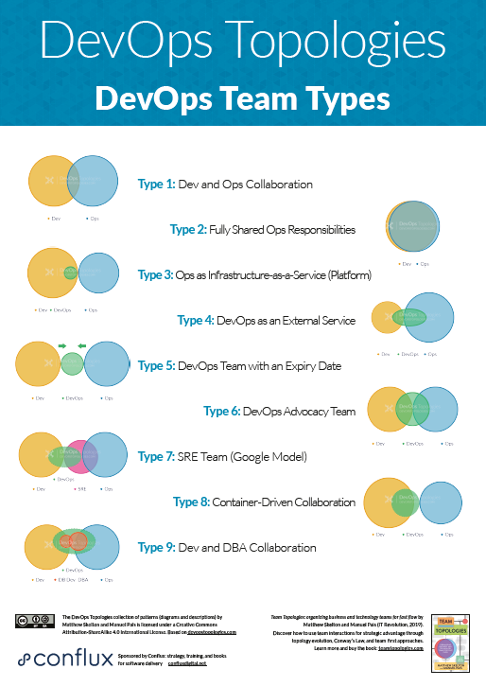
ADODD > Big Picture > Continuous Delivery > Best Practices
Build should pass in less than 5 min
Always commit small changes
Implement (and expand) Continuous Integration
Always have one stop between development and production
Deploy to every environment the same way
Automate everything

Slide 13
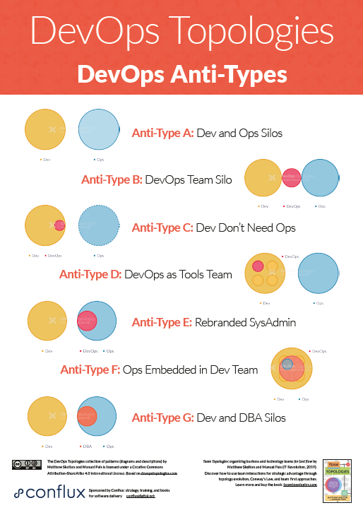
ADODD > Big Picture > Continuous Delivery > Common mistakes
Choosing the wrong team to do the job
Starting without a plan
Emphasizing process over quality
Getting rigid during implementation
Failing to break down Dev & Ops silos
Taking security for granted
Using to many new technologies

Slide 14

ADODD > Big Picture > Continuous Delivery > Demo

Slide 15


ADODD > Big Picture

Slide 16
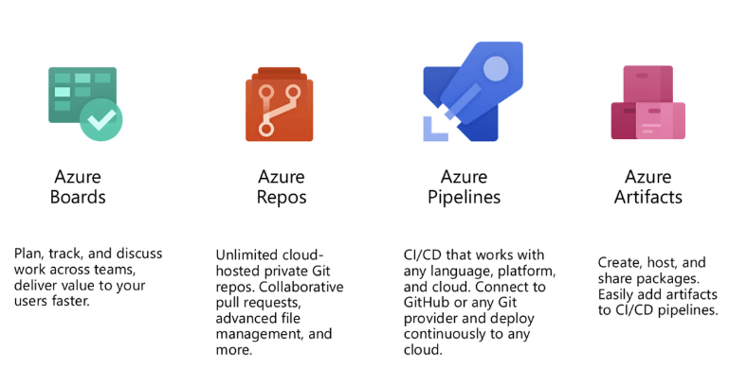
ADODD > Projects
Boards allow us to map business requirements to actionable work items
Artifacts allow us to bundle and share our work
Repos allow us to manage, share and version our work
Pipelines allow us to build and release our work

Slide 17
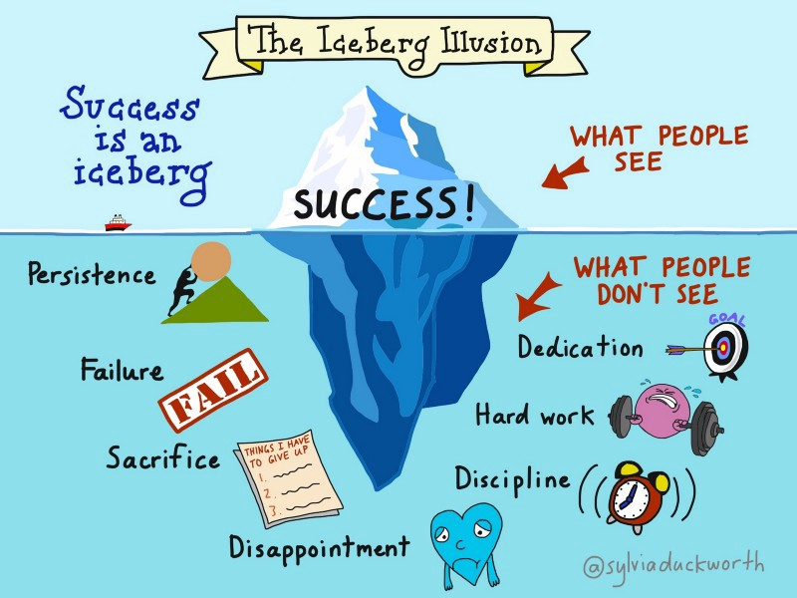
ADODD > Projects > Lab

Slide 18
ADODD > Projects > Lab
Navigate to github.com and sign-in with a valid user account
Create a new repository called ADODD-Demo
Navigate to dev.azure.com and sign-in with a valid user account
Create a new organization named: dev.azure.com/{my-unique-org-name}
Create a new project named: ADODD-Demo
Go to Project Settings > GitHub Connection and connect to a Git repository
Go to https://github.com/settings/tokens and generate a new personal access token (PAT)
Go to Project Settings > Service Connection and setup a new GitHub connection that uses our newly created PAT

Slide 19
ADODD > Projects

Slide 20
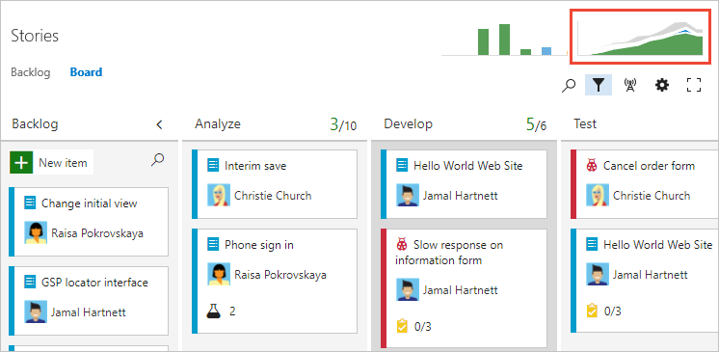
ADODD > Boards
Boards are ”process pipelines” for work items, which are the primary “unit of work” in projects
Boards reference backlogs to plan, prioritize and organize work items
Boards uses sprint backlogs to manage iterations and maintain agility
Boards uses queries to group work items across projects

Slide 21
ADODD > Boards > Lab

Slide 22
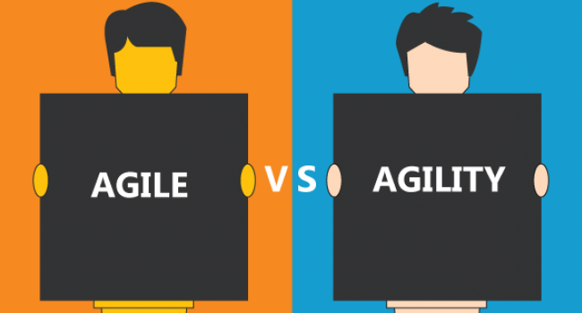
ADODD > Boards > Lab
Add “blocked” and “review” columns to the default board
Add “enablers” and “features” swinlanes to the default board
Create three work items in the default backlog
Setup three fixed-length sprints
Allocate one work item to each sprint
Configure a “work in progress” query to easily figure out what we are working on

Slide 23
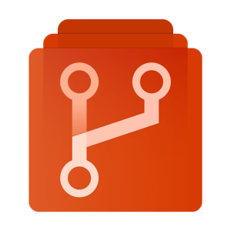
ADODD > Repos
Repos belong to projects
Repos use commits to track changes
Repos enables branching to support collaboration
Repos use Pull Requests to commit changes and update work items

Slide 24
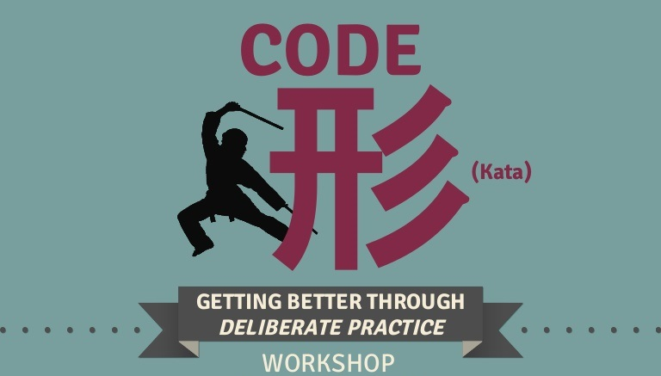
ADODD > Repos > Code Kata #1

Slide 25
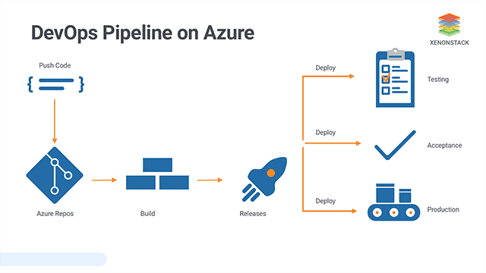
ADODD > Pipelines
Pipelines is used by projects to build and publish artifacts
Pipelines use environments to ”mimic” deployment targets
Pipelines use releases to deploy artifacts
Pipelines owns libraries of variables and files that can be referenced from anywhere in a project

Slide 26
ADODD > Pipelines > Lab

Slide 27
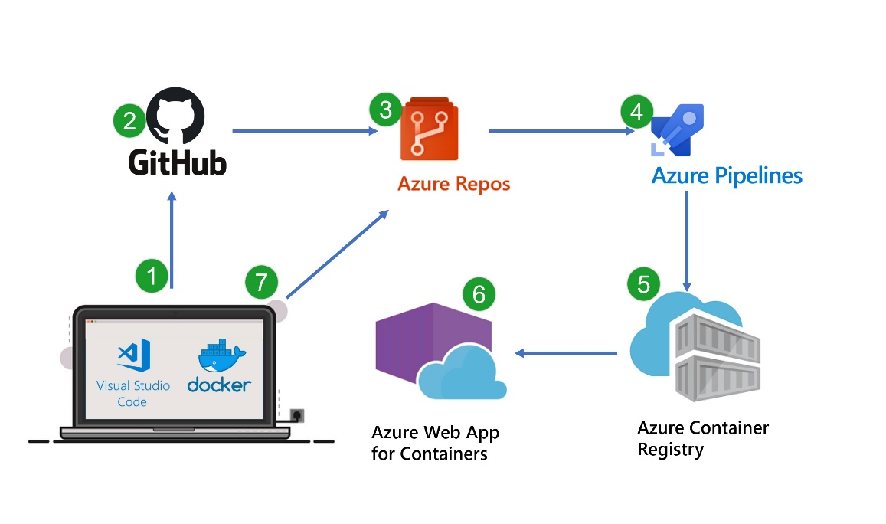
ADODD > Pipelines > Lab
Create a new pipeline named “My-Repo-Build”
Choose the “Azure Repos Git” option, select “my-repo” and use the “ASP.NET Core” template
Click “Save & Run” to verify that our new pipeline works as intended
Navigate to “my-repo” and verify that file named “azure-pipelines.yml” has been added to our master branch
Add a “pack” task that uses the .NET Core CLI to package our code
Notes:
task: DotNetCoreCLI@2
displayName: "Pack"
inputs:
command: 'pack'
packagesToPack: '**/*.csproj'
versioningScheme: 'off'

Slide 28
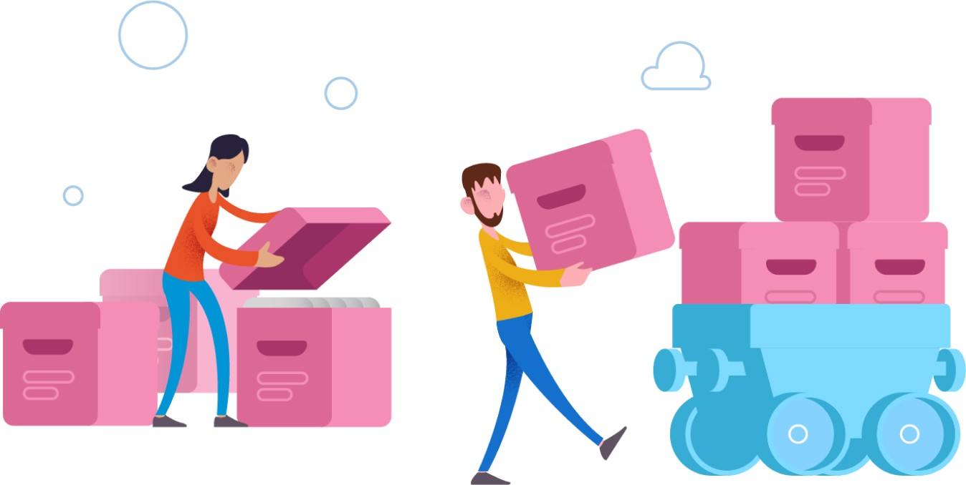
ADODD > Artifacts
With Azure Artifacts you can package and publish your application assets as versioned archives.
With Azure Artifacts you can create and share feeds from public and private package sources with teams of any size.

Slide 29
ADODD > Artifacts > Lab

Slide 30
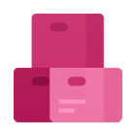
ADODD > Artifacts > Lab
Go to “Artifacts” and create a new feed called “my-nuget-feed”
Add a “publish” task that uses the .NET Core CLI to publish our code to the “my-nuget-feed” ID format for publishVstsFeed arguments is {project-id}/{feed-id}
Re-run the “My-Repo-Build” pipeline
Notes:
task: DotNetCoreCLI@2
displayName: "Publish"
inputs:
command: 'push'
packagesToPush: '$(Build.ArtifactStagingDirectory)/*.nupkg'
nuGetFeedType: 'internal'
publishVstsFeed: '{project-id}/{feed-id}
'

Slide 31
ADODD > Feedback
https://airtable.com/shrDUlkEelfraVzON

Slide 32
ADODD > Literature
https://docs.microsoft.com/en-us/azure/devops/?view=azure-devops
https://docs.microsoft.com/en-us/azure/devops/learn/what-is-devops
https://www.codeproject.com/Articles/1394594/Devops-The-Big-Picture
https://www.sumologic.com/insight/continuous-delivery-best-practices/
https://hackernoon.com/the-last-mile-to-true-continuous-delivery-6sk323j
https://devops.com/common-mistakes-developers-commit-when-integrating-devops/

